Slide 1

MINI PROJECT II (2021-22) SYNOPSIS GLAU Sports
SUBMITTED BY :-
HARSHIT BHATIA(181500252)
HIMALAYA SINGH(181500266)
GAGAN SARASWAT(181500231)
MUKUL GOYAL (181500398)
Saumya Singh (181500633)
Shubham Srivastav(181500699)
Supervised By :
Mr. Neeraj Khanna(Assistant Professor)

Slide 2
Acknowledgement
We have taken efforts in this project. However, it would not have been possible without the kind support and help of many individuals and organizations. I would like to extend my sincere thanks to all of them.
I am highly indebted to Mr. Neeraj Khanna for their guidance and constant supervision as well as for providing necessary information regarding the project & also for their support in completing the project.
I would like to express my gratitude towards my parents & member of GLA University for their kind co-operation and encouragement which help me in completion of this project.
My thanks and appreciations also go to my colleague in developing the project and people who have willingly helped me out with their abilities.

Slide 3

CONTENT
Introduction
Objectives
Modules
System Requirements
Hardware Requirements
Advantages
Limitation
Application

Slide 4

Introduction
In the proposed GLAU Sports student can get all the information of various games and the venue. The student can get registered from anywhere and at any time. By using this system student can save a lot of time and effort. The student can easily get the information from anywhere.

Slide 5
Objective
The GLAU Sports objective is to provide which manages the activity of many sports at a time. It also manages the selection activity of students to college and to state level. The users will consume less amount of time when compared to manual paper work through the automated system. The system will take care of all the servicing activity in a quick manner.
Data storing is easier. It will be able to check any report at any time. Paper work and manual work is reduced. The system is user friendly and easy to use.
Goal oriented
Deliberately Structured
Deliberately Coordinated
Exist as a system of individuals and groups
Made up of people with special skills
It is a product to manage games/sports played at schools. This is an application that was developed to keep track of different sporting events with multiple games played between multiple schools and students.

Slide 6
Modules
This Project has following Modules:
Admin
User
1) Admin Module
Master
Login Register
Student Register
Tournament

Slide 7
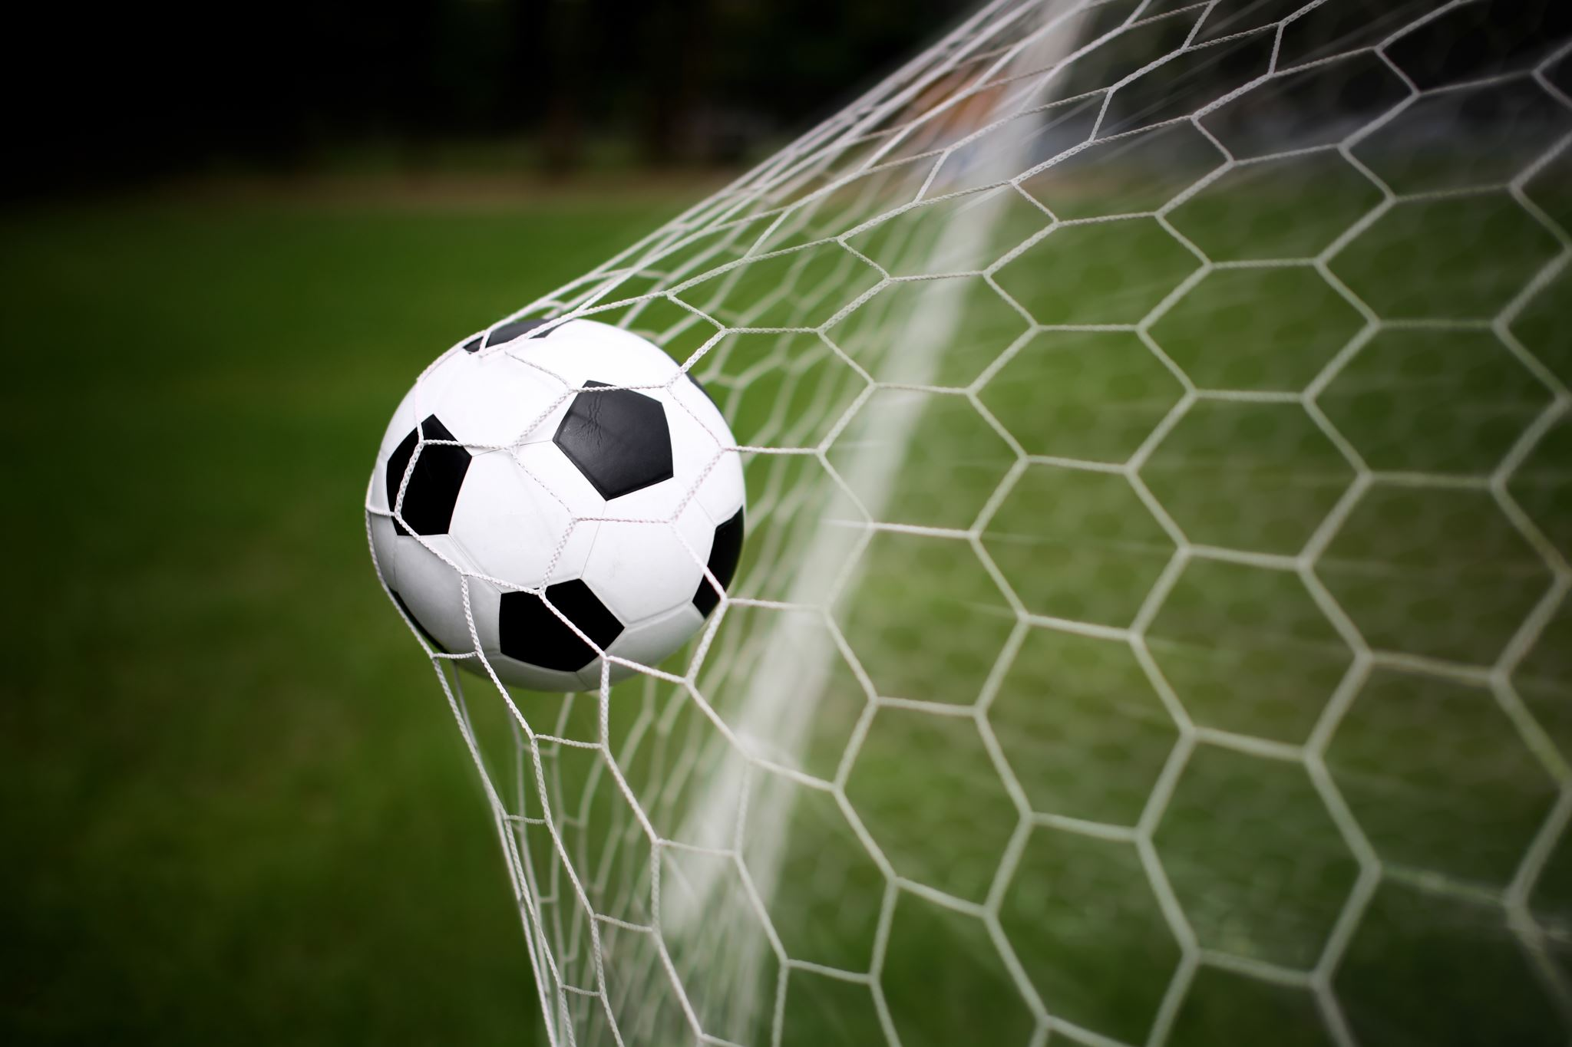
Games
Football
Players
Tournament
Photos
Cricket
Players
Tournament
Photos
Hockey
Players
Tournament
Photos
Volleyball
Players
Tournament
Photos

Slide 8
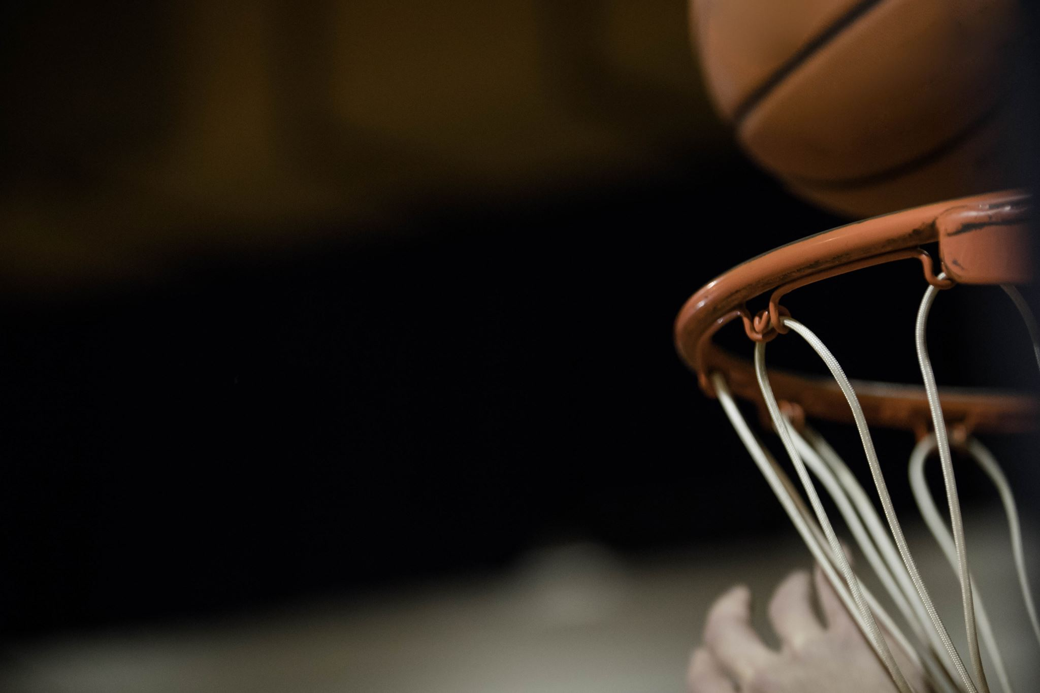
Badminton
Players
Tournament
Photos
Basketball
Players
Tournament
Photos
Level
College
State
Logout

Slide 9
System Requirements
Supported Operating system: -
Windows 10
Windows 8
Windows 7
Software Required: -
● Android Studio
● Intelli J

Slide 10
Hardware Requirements
Android Studio and Intelli j: -
Intel i3 6 th Gen (1.8 GHz minimum).
4 GB of RAM.
2GB GPU
5000x Hard Disk
Internet Connection

Slide 11
Advantages And Limitations
Limitations:
Lack of security.
This system does not provide category wise classifications of products.
Inefficiency in querying details.
Periodic Report generation takes lot of time.
Advantages
Reduce complexity in managing the data related to the agriculture products, soils, fertilizers, mandi/market details.
The system also does the selection procedure to the college level and the state level competition.
To the college level all the players are allowed to play. Whereas to the state level, the best players will be selected from the college level list which will be also saved in the database.
Current system provides different access levels for security.
Rich user interface is provided in order to interact with application.
Reports are generated dynamically on a periodic basis.

Slide 12
Application
Used in Colleges and Universities.

